Slide 1

Flight Delays
Frazer Akomprah

Slide 2
Agenda
Introduction
Project Overview
Hypothesis
Data Preparation and Analysis
Summary

Slide 3

Introduction
Flight delays can diminish customer loyalty, cause financial penalties and disrupt business.
Insight about leading factors, underlying causes and trends becomes valuable to airline carriers to enhance performance.
Hypothesis
Flight delays can be unavoidable under certain conditions such as weather conditions, air trafficking or any unanticipated occurrence.
Some reasons for Flight delays can be dealt with by improving the flight process and experience.
Statistics of the flight delays is a vital factor in understanding the flight’s operation and performance.
Aircraft delays, Carrier delay.
Unique Carrier
Arrival and Dep delays
Number of flights delayed
Delay reason
3

Slide 4
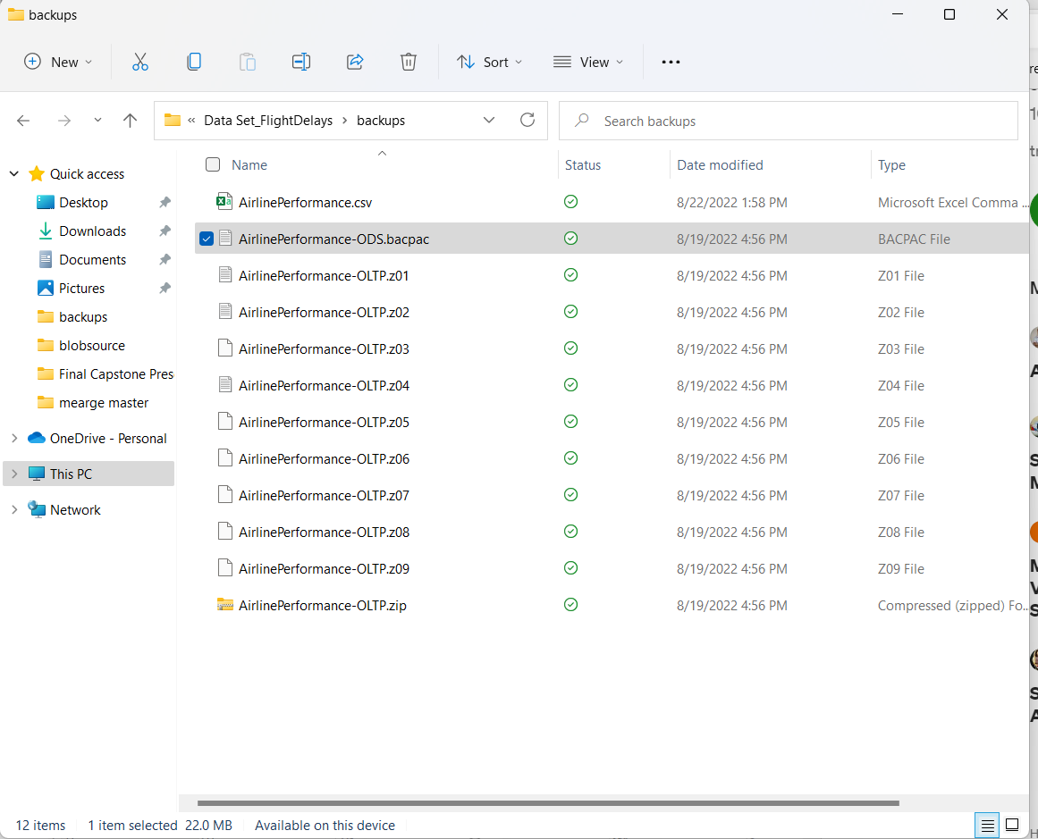
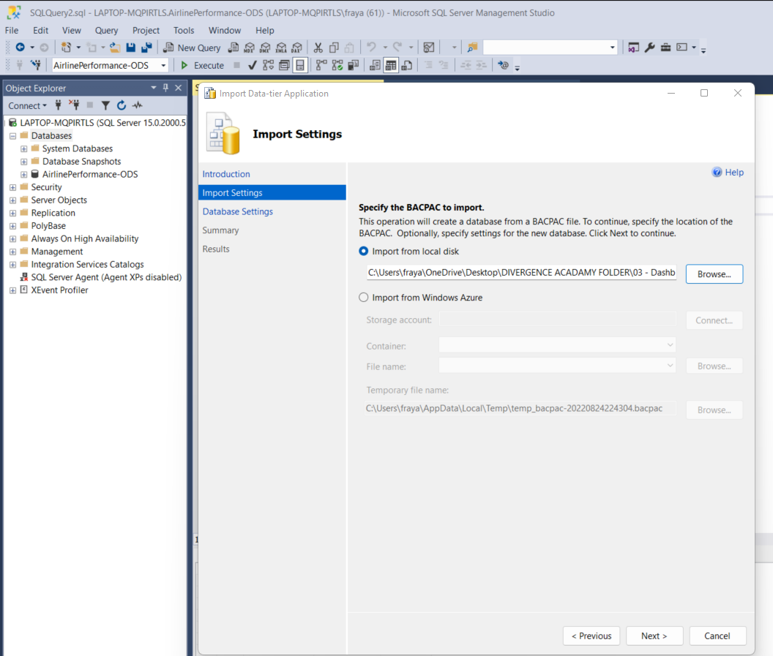
Data Preparation

Slide 5
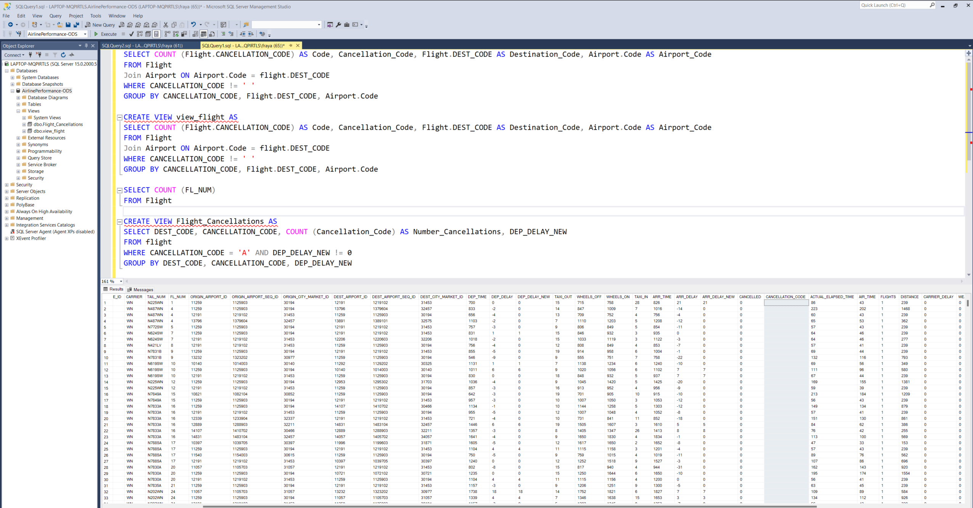
Data Preparation in SQL

Slide 6
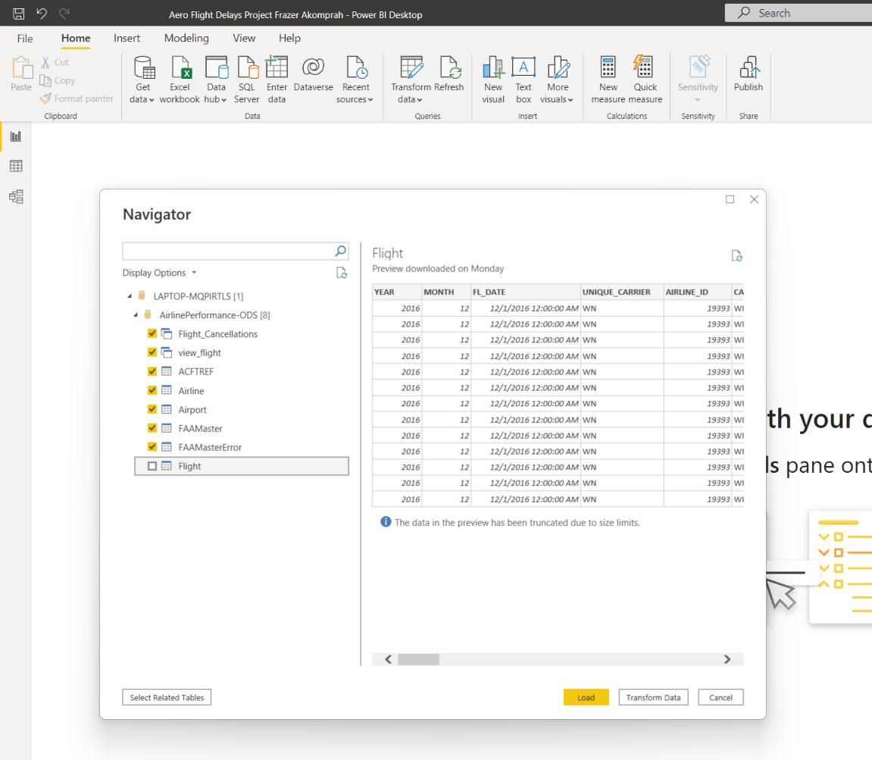
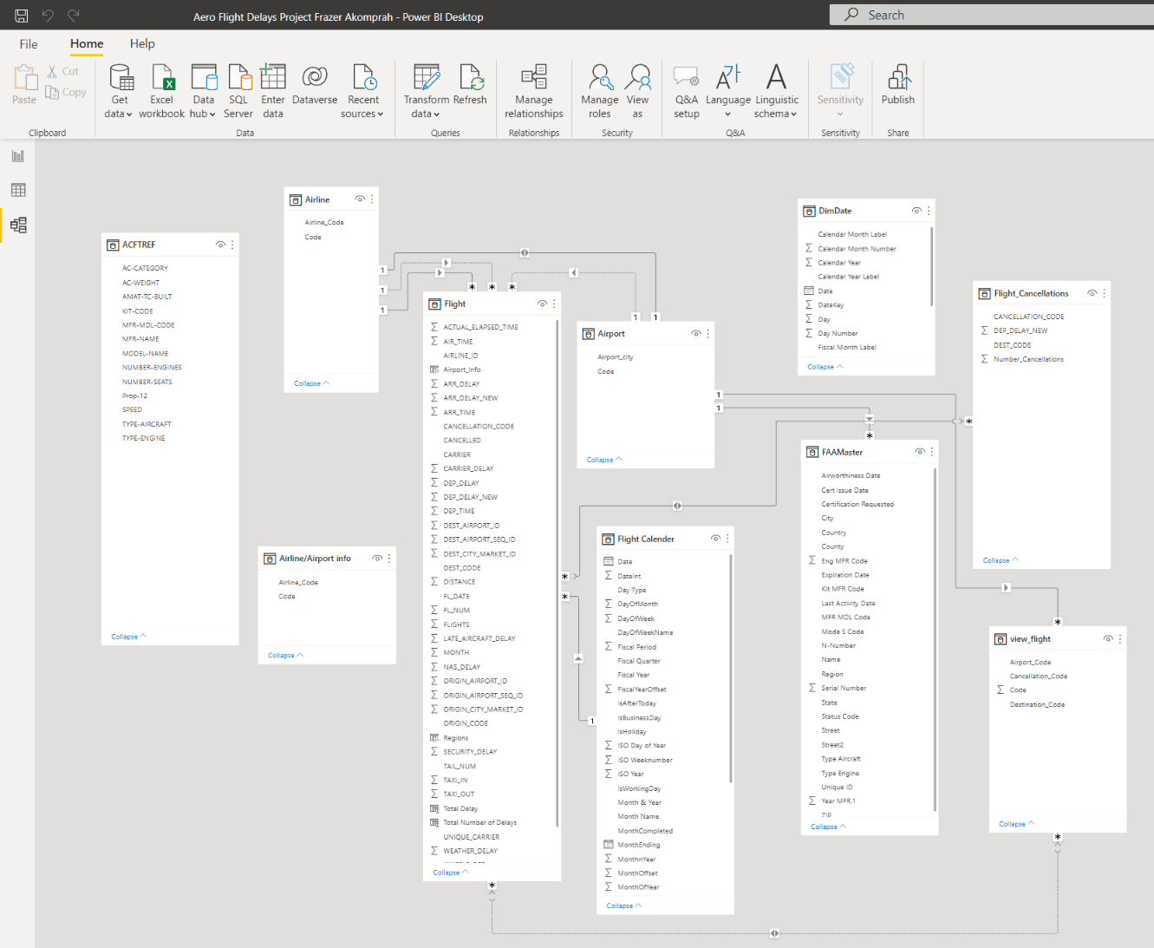
Data Import and Model in Power BI

Slide 7
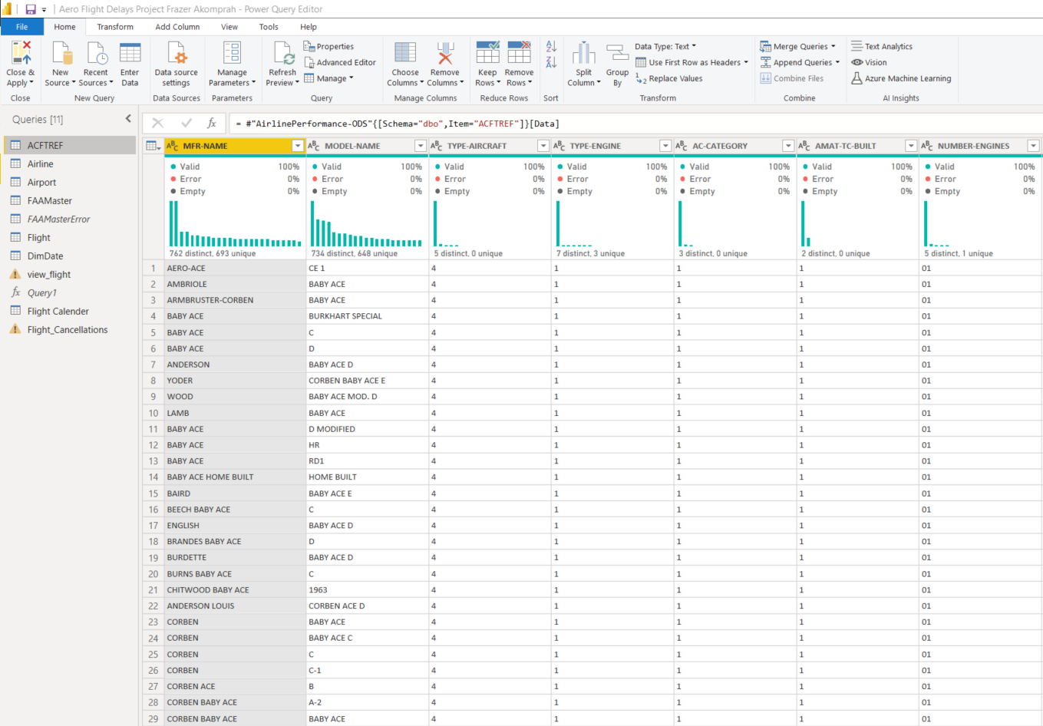
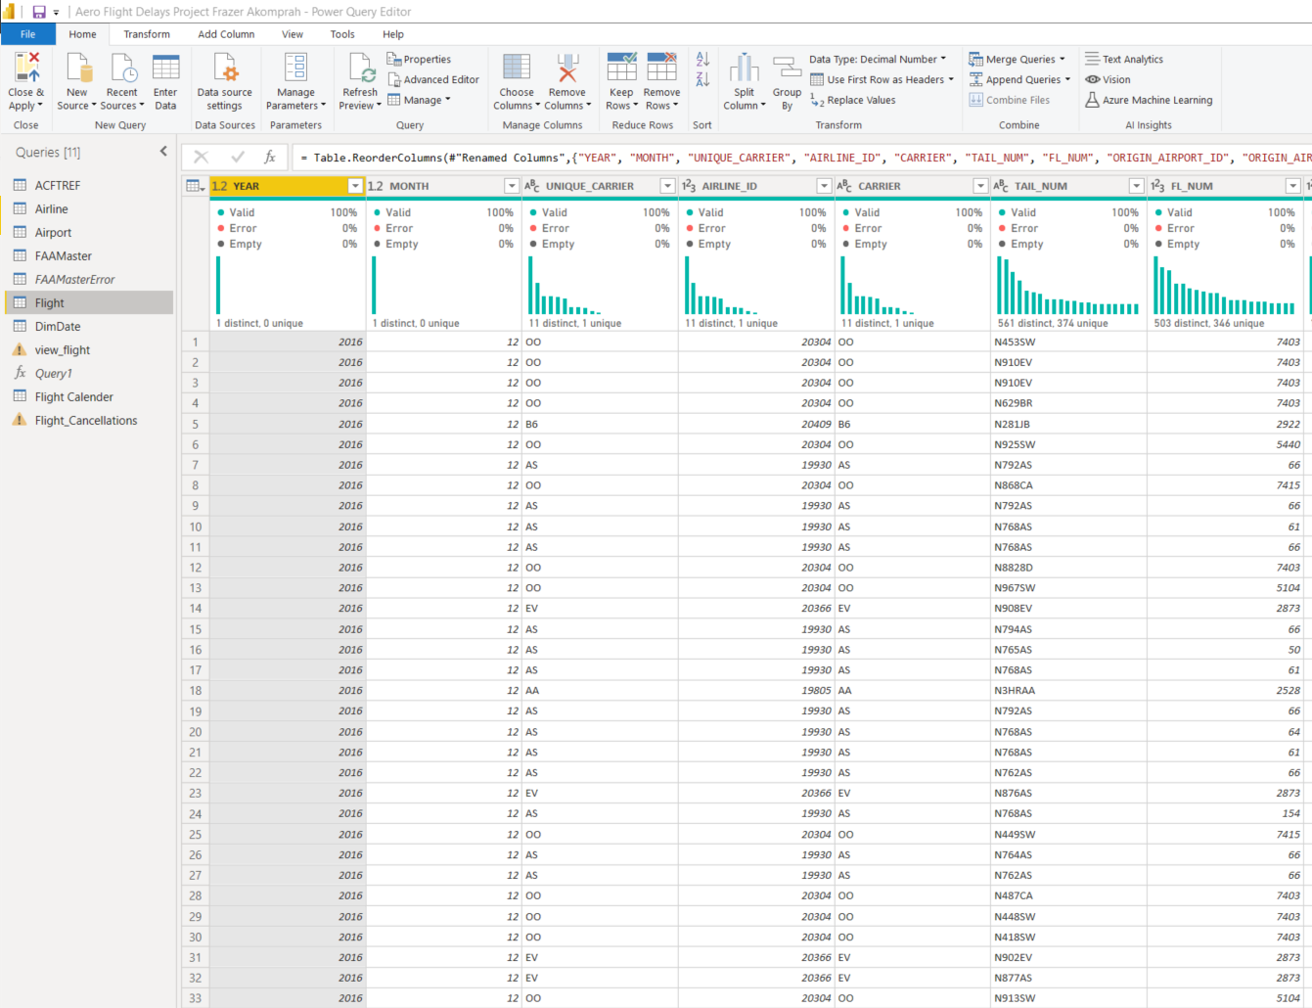
Data Preparation Using Power Query

Slide 8
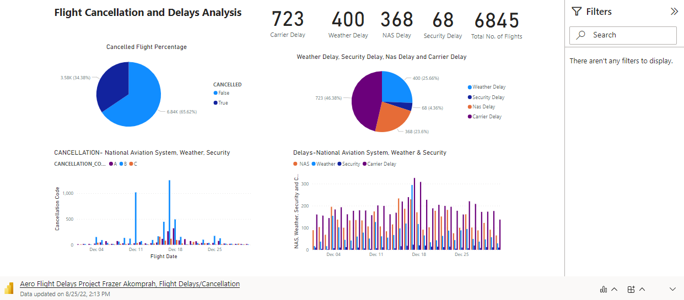
Data Visualization with Power BI

Slide 9

Data Visualization with Power BI

Slide 10
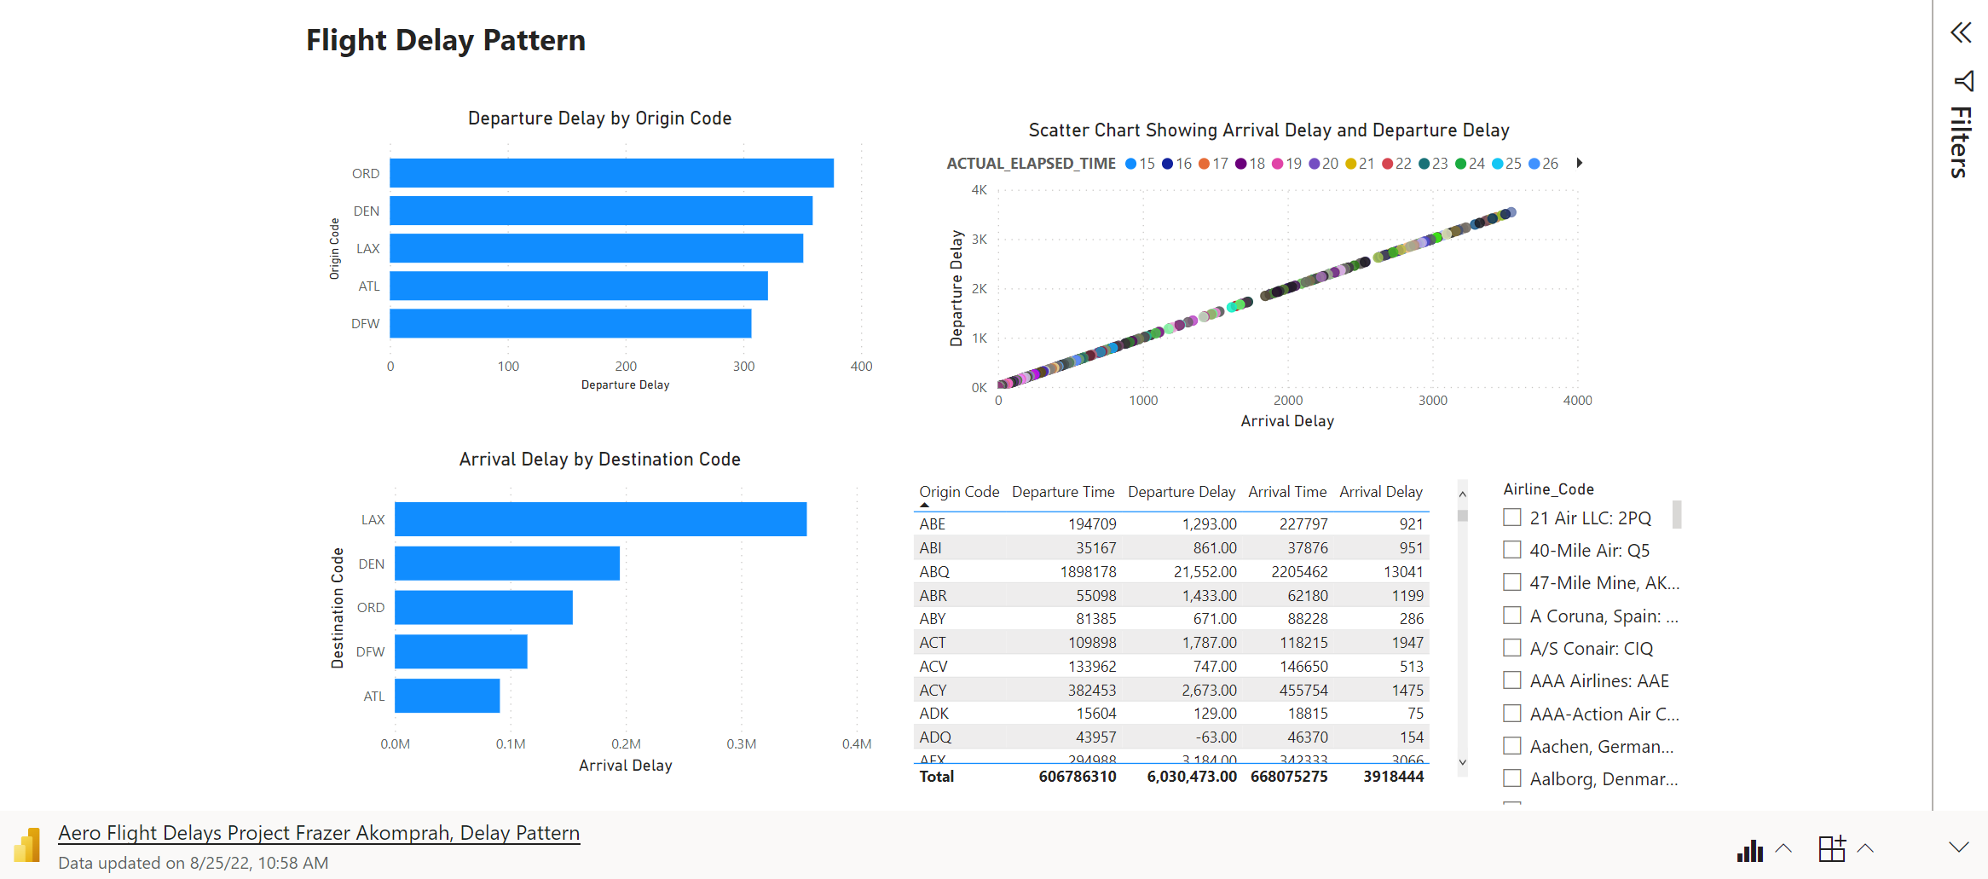
Data Visualization with Power BI

Slide 11
Summary
40% of flight delays are caused by the late arrival of the aircraft and propagation delay, where if a flight is delayed, a subsequent flight is also affected;
23.6% of disruptions are the result of a National Aviation System decision
4.36% of the delays are as a result of security delays
25.66% are caused by bad weather. Extreme weather conditions are the most obvious cause for delay in flights;
Lastly about 46.38% of delays lie within the responsibility of the air carrier. Air carrier delay could result from baggage loading, maintenance problems, refueling or even crew punctuality.

Slide 12


Thank You

